Slide 1
Ag & Wind Energy
Lesson 6

Slide 2
What are wind turbines?
https://youtu.be/YzgWUzTKYIs

Slide 3
Types of wind power
Mechanical Wind Power: Wind turbines convert the kinetic energy of the wind into mechanical power. This mechanical power can be used directly to pump water, mill grain or otherwise drive a gearbox.
Livestock watering tanks in remote areas
Irrigation systems
Field drainage systems

Slide 4
Types of wind power
Electrical Wind Power: Wind rotates blades by force and by creating low pressure on the backside like an airplane wing. Blade rotation is “geared up”. Spinning shaft drives generator creating electricity. Power is sent down tower for direct use or into electric grid.
Small-scale (under 100 kW) can provide all or part of residential & farm energy needs.
Commercial-scale now reach 500 feet and can produce 7 MW (7,000 kilowatts)!

Slide 5
Benefits and limitations of wind power
Economies of Scale:
The average installed cost of a small-scale turbine in the U.S. is $3,000-5,000 per kW, which is 2½ times the cost of large turbines (per watt).
With tax credits, rebates and utility purchase agreements, small turbine owners can pay for their system within 10 years, then enjoy free power

Slide 6
Benefits and limitations of wind power
Rural Economic Benefits: Iowa’s 240 MW of wind energy has produced the following economic benefits:
$640,000/yr in lease payments to farmers (approx. $2,000/turbine/yr)
$2 million/yr in property taxes
$5.5 mil/yr in operations and maintenance income
40 long-term operations and maintenance jobs
200 short-term construction jobs

Slide 7
Benefits and limitations of wind power
Leasing and cooperative ownership: Farmers/landowners can lease their land for wind energy development or pursue collective ownership of their own turbine(s) through co-ops.

Slide 8
Benefits and limitations of wind power
Variability of Resource: the available wind powering turbines may change throughout the day and year.
Limitations to Farming: include aerial crop-dusting and maneuvering large equipment in the field.
Noise/Strobe Effect/Aesthetics: Turbines do make noise and they are big and may disrupt views. Be sensitive to your neighbors. Talk to them during the planning process and find out their concerns. If possible, place your turbines where they will be least seen and heard by neighbors

Slide 9
Benefits and limitations of wind power
Environmental Impacts: Wind energy is non-polluting and therefore a good environmental choice. But any time we produce energy, we run the risk of disrupting ecosystems. Wind turbines are no different. They are not allowed in wetlands or other sensitive areas, and they also should not be located in migratory bird flyways because, like any large structure, they can kill birds. You may not want to place turbines in scenic areas where they will detract from the view.
Polluting Manufacturing Process
Fate of Towers Once Decommissioned

Slide 10
Benefits and limitations of wind power
The amount of potential wind power worldwide is more than four times the total annual power consumption of the entire world (72 terawatts).
The amount of kinetic wind energy within Earth's atmosphere is equal to ~10,000 trillion kW-hours.

Slide 11
What makes a good site for wind energy generation?
Identify your wind resource: State energy potential
http://apps2.eere.energy.gov/wind/windexchange/wind_maps.asp

Slide 12
Zoning
Residentially zoned areas often have a height limit of 35 feet.
Any wind turbine is subject to local zoning laws.
Some states also have requirements based on the size of electric generating facilities.
For example, 25 MW or larger projects to be installed in Minnesota must receive a permit from the Public Utilities Commission which requires an environmental impact statement (EIS).
State permits usually supersede local zoning laws.
Federal Aviation Authority (FAA) must permit every structure over 200 feet tall that is near the airport or within flight paths.

Slide 13
Site selection
Wind turbines are mounted on a tower to capture the most energy.
At 100 feet (30 meters) or more above ground, they can take advantage of faster and less turbulent wind.
This also minimizes disturbance from obstacles such as buildings and trees.

Slide 14
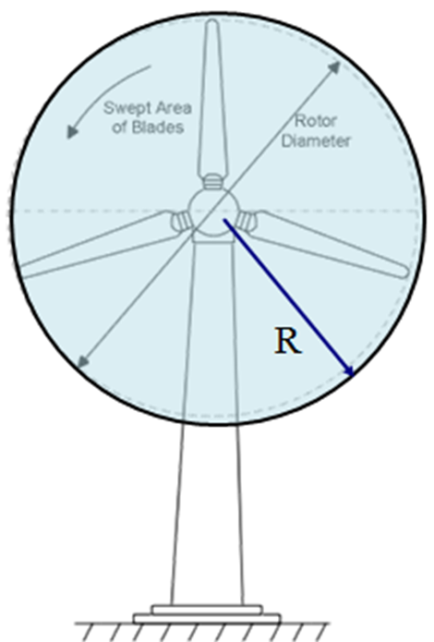
Estimate potential power: Power in the wind = ½ρAV³
A = Effect of swept area (Swept Area: A = πR² Area of the circle swept by the rotor (m²).
V = Effect of wind speed
ρ = Effect of air density
Power is a cubic function of wind speed V x V x V
20% increase in wind speed means 73% more power
Doubling wind speed means 8 times more power!

Slide 15
Ownership
Once you have determined that you have a strong wind resource and your property is suitable for development, you will want to decide what level of involvement in the project you are comfortable with. There are three basic ways to undertake wind energy development:
Lease your land to a wind developer
Join with others in investing
Own the turbine(s) yourself

